Slide 1
Review and Preview
Data Structures and Algorithms
Nanjing University, Fall 2020
郑朝栋

Slide 2
(Very) Brief Review
Some important data structures
list, stack, queue, heap, graph, …
hash tables, search trees, disjoint sets, …
Some classical algorithms
sorting and selection, tree/graph traversal, …
MST, shortest paths, network flow, …
Basic algorithm design and analysis techniques
induction, asymptotic notations, amortized analysis, …
recursion, divide-and-conquer, greedy, dynamic programming
Basic complexity theory
upper bounds and lower bounds (decision tree, adversary argument)
computability and complexity (P, NP, NPC)
Use computers to efficiently solve practical problems.
(Analytical and problem-solving skills.)

Slide 3
Approximation Algorithms

Slide 4
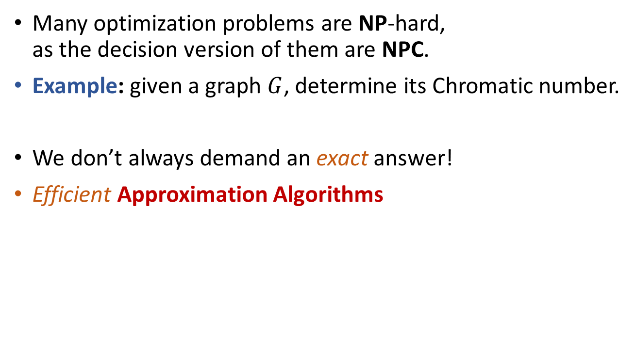
Dealing with NP-hard problems…
Many optimization problems are NP-hard, as the decision version of them are NPC.
Example: given a graph $G$, determine its Chromatic number.
We don’t always demand an exact answer!
Efficient Approximation Algorithms

Slide 5
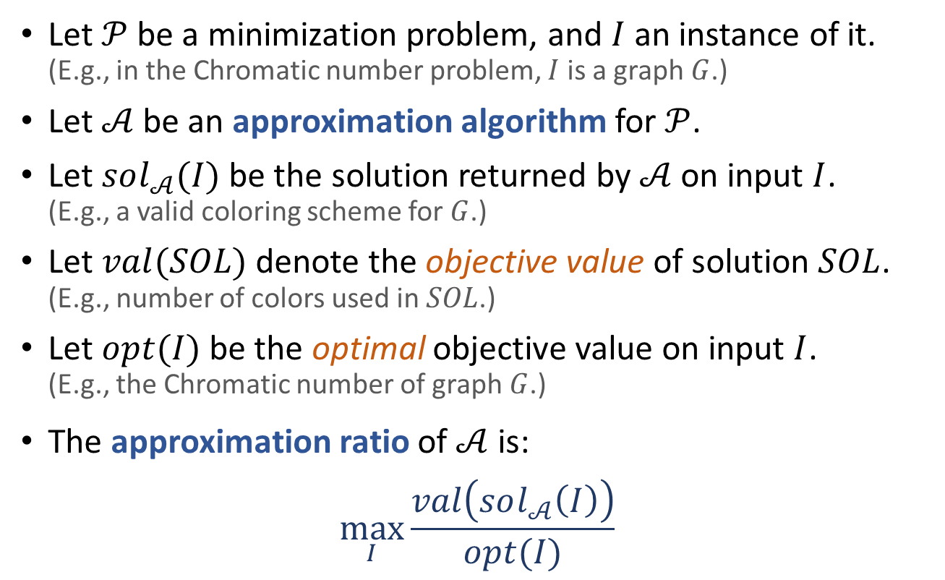
Approximation Ratio
Let $𝒫$ be a minimization problem, and $I$ an instance of it. (E.g., in the Chromatic number problem, $I$ is a graph $G$.)
Let $𝒜$ be an approximation algorithm for $𝒫$.
Let $sol_{𝒜}(I)$ be the solution returned by $𝒜$ on input $I$. (E.g., a valid coloring scheme for $G$.)
Let $val(SOL)$ denote the objective value of solution $SOL$. (E.g., number of colors used in $SOL$.)
Let $opt(I)$ be the optimal objective value on input $I$. (E.g., the Chromatic number of graph $G$.)
The approximation ratio of $𝒜$ is: $\max_{I}{\frac{val\left(sol_{𝒜}\left(I\right)\right)}{opt(I)}}$
What if the optimization problem is a maximization problem?

Slide 6
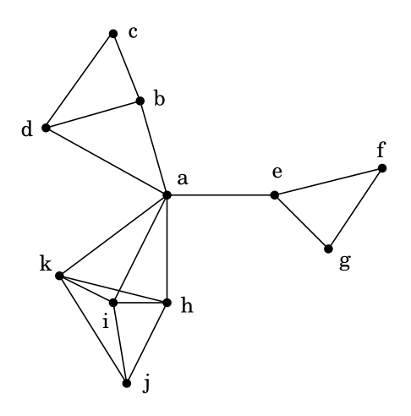
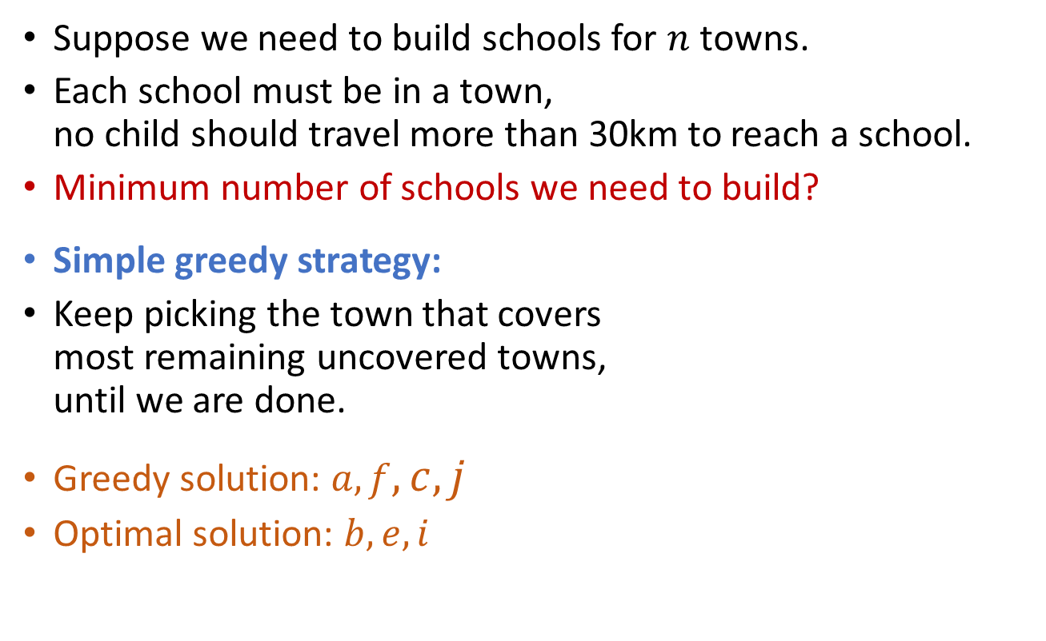
Set Cover
Suppose we need to build schools for $n$ towns.
Each school must be in a town, no child should travel more than 30km to reach a school.
Minimum number of schools we need to build?
Simple greedy strategy:
Keep picking the town that covers most remaining uncovered towns, until we are done.
Greedy solution: $a,f,c,j$
Optimal solution: $b,e,i$

Slide 7
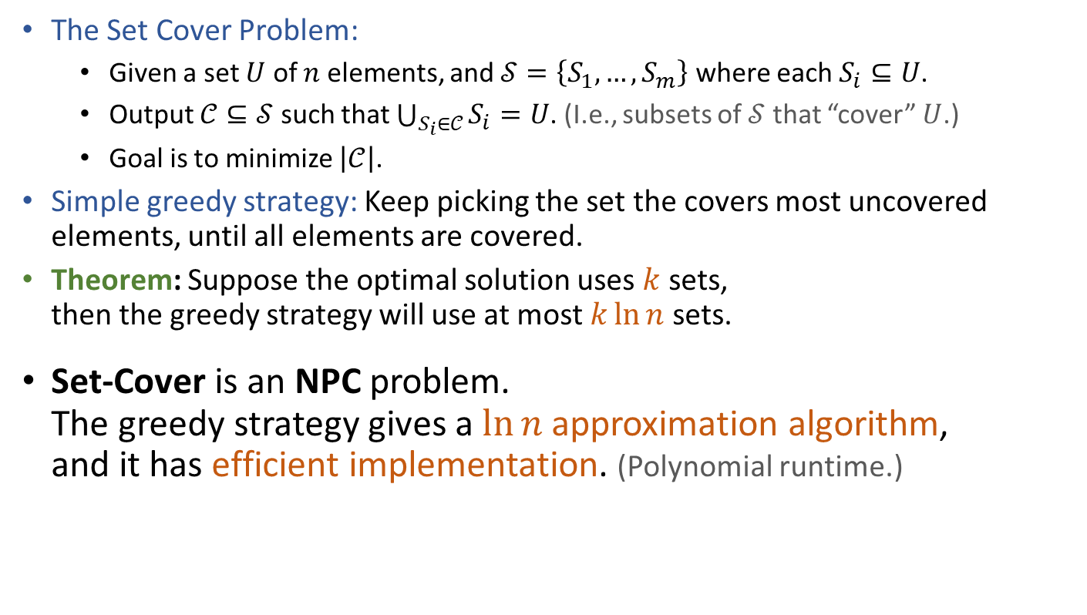
Set Cover Greedy solution is close to optimal
The Set Cover Problem:
Given a set $U$ of $n$ elements, and $𝒮=\left\{S_{1},…,S_{m}\right\}$ where each $S_{i}⊆U$.
Output $𝒞⊆𝒮$ such that $\bigcup_{S_{i}∈𝒞}{S_{i}}=U$. (I.e., subsets of $𝒮$ that “cover” $U$.)
Goal is to minimize $\left|𝒞\right|$.
Simple greedy strategy: Keep picking the set the covers most uncovered elements, until all elements are covered.
Theorem: Suppose the optimal solution uses $k$ sets, then the greedy strategy will use at most $k\ln{n}$ sets.
Set-Cover is an NPC problem. The greedy strategy gives a $\ln{n}$ approximation algorithm, and it has efficient implementation. (Polynomial runtime.)

Slide 8
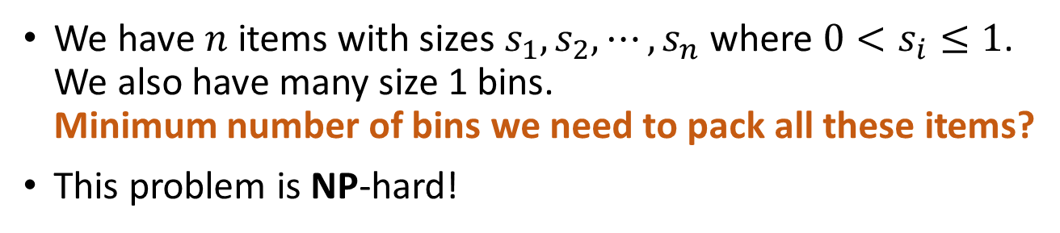
Bin Packing
We have $n$ items with sizes $s_{1},s_{2},⋯,s_{n}$ where $0<s_{i}≤1$. We also have many size 1 bins. Minimum number of bins we need to pack all these items?
This problem is NP-hard!
…
0.2
0.4
0.4
0.5
0.2
0.3
0.8

Slide 9
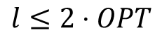
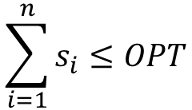
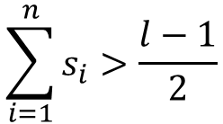
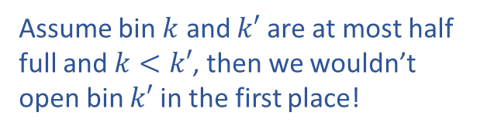
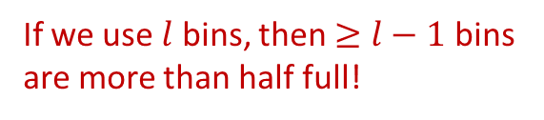
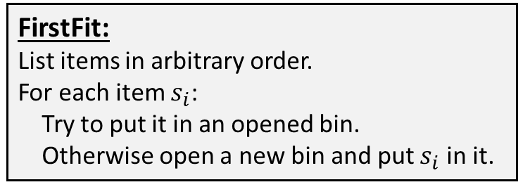
First Fit
FirstFit:
List items in arbitrary order.
For each item $s_{i}$:
Try to put it in an opened bin.
Otherwise open a new bin and put $s_{i}$ in it.
If we use $l$ bins, then $≥l−1$ bins are more than half full!
Assume bin $k$ and $k′$ are at most half full and $k<k′$, then we wouldn’t open bin $k′$ in the first place!
$$\sum_{i=1}^{n}{s_{i}}>\frac{l−1}{2}$$
0.2
0.8
…
0.4
0.4
0.5
0.2
0.3
$$\sum_{i=1}^{n}{s_{i}}≤OPT$$
0.2
0.3
0.8
0.4
0.4
$$l≤2⋅OPT$$
0.2
0.5
FirstFit is a 2-approximation algorithm.

Slide 10
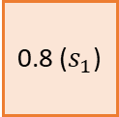
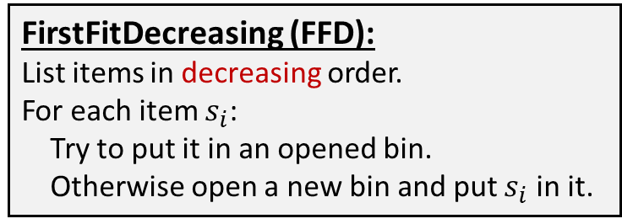
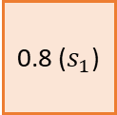
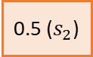
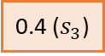
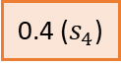
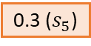
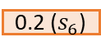
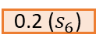
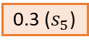
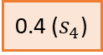
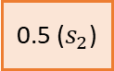
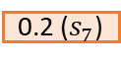
First Fit Decreasing (FFD)
FirstFitDecreasing (FFD):
List items in decreasing order.
For each item $s_{i}$:
Try to put it in an opened bin.
Otherwise open a new bin and put $s_{i}$ in it.
0.2 ($s_{6}$)
0.4 ($s_{3}$)
0.2 ($s_{7}$)
…
0.8 ($s_{1}$)
0.3 ($s_{5}$)
0.5 ($s_{2}$)
0.4 ($s_{4}$)
0.8 ($s_{1}$)
0.4 ($s_{3}$)
0.2 ($s_{6}$)
0.4 ($s_{4}$)
0.2 ($s_{7}$)
0.5 ($s_{2}$)
0.3 ($s_{5}$)

Slide 11
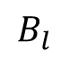
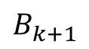
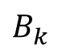
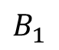
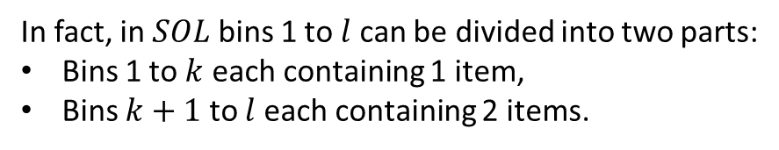
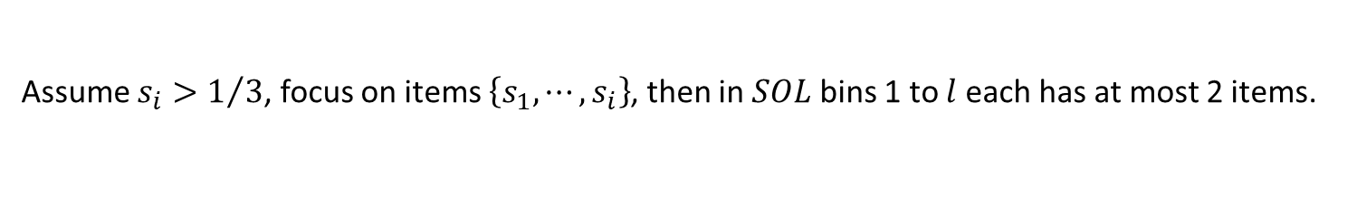
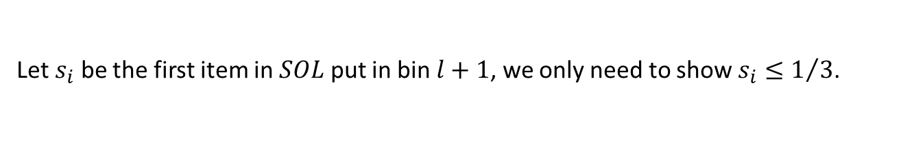
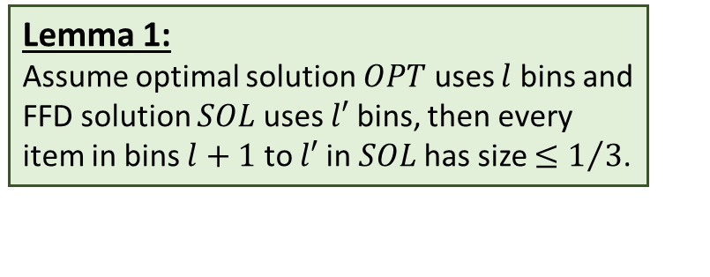
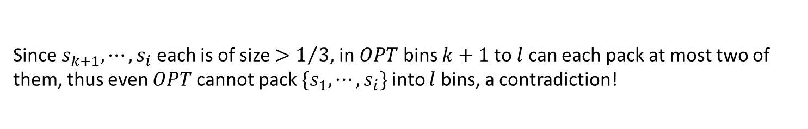
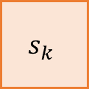
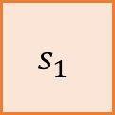
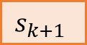
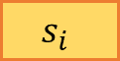
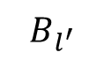
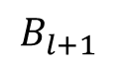

FirstFitDecreasing (FFD):
List items in decreasing order.
For each item $s_{i}$:
Try to put it in an opened bin.
Otherwise open a new bin and put $s_{i}$ in it.
Lemma 1:
Assume optimal solution $OPT$ uses $l$ bins and FFD solution $SOL$ uses $l′$ bins, then every item in bins $l+1$ to $l′$ in $SOL$has size $≤1/3$.
Let $s_{i}$ be the first item in $SOL$ put in bin $l+1$, we only need to show $s_{i}≤1/3$.
Assume $s_{i}>1/3$, focus on items $\left\{s_{1},⋯,s_{i}\right\}$, then in $SOL$ bins 1 to $l$ each has at most 2 items.
In fact, in $SOL$ bins 1 to $l$ can be divided into two parts:
Bins 1 to $k$ each containing 1 item,
Bins $k+1$ to $l$ each containing 2 items.
In $OPT$, there will be $k$ bins that do not contain any of $s_{k+1},⋯,s_{i}$. Say they are the first $k$ bins.
(Because in $OPT$, $s_{1},⋯,s_{k}$ must each occupy a bin alone as well.)
Since $s_{k+1},⋯,s_{i}$ each is of size $>1/3$, in $OPT$ bins $k+1$ to $l$ can each pack at most two of them, thus even $OPT$ cannot pack $\{s_{1},⋯,s_{i}\}$ into $l$ bins, a contradiction!
…
…
…
$$s_{1}$$
$$s_{k}$$
$$s_{k+1}$$
$$s_{i}$$
$$B_{1}$$
$$B_{k}$$
$$B_{k+1}$$
$$B_{l}$$
$$B_{l+1}$$
$$B_{l^{′}}$$

Slide 12
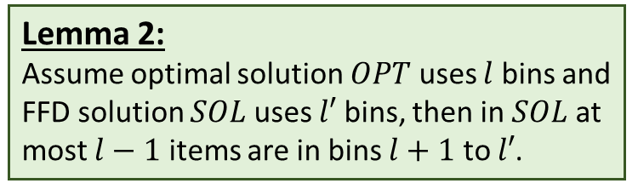
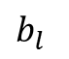

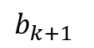
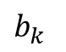
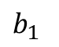
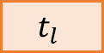
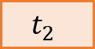
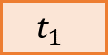

FirstFitDecreasing (FFD):
List items in decreasing order.
For each item $s_{i}$:
Try to put it in an opened bin.
Otherwise open a new bin and put $s_{i}$ in it.
Lemma 1:
Assume optimal solution $OPT$ uses $l$ bins and FFD solution $SOL$ uses $l′$ bins, then every item in bins $l+1$ to $l′$ in $SOL$has size $≤1/3$.
Lemma 2:
Assume optimal solution $OPT$ uses $l$ bins and FFD solution $SOL$ uses $l′$ bins, then in $SOL$ at most $l−1$ items are in bins $l+1$ to $l′$.
Assume $SOL$ puts at least $l$ items in bins $l+1$ to $l′$. Assume $l$ of them have sizes $t_{1},⋯,t_{l}$.
For $1≤j≤l$, let $b_{j}$ denote the final occupied space of bin $j$ in $SOL$.
For $1≤j≤l$, it must be the case $b_{j}+t_{j}>1$, otherwise $t_{j}$ can be put in bin $j$.
$\sum_{i=1}^{n}{s_{i}}≥\sum_{j=1}^{l}{b_{j}}+\sum_{j=1}^{l}{t_{j}}>\sum_{j=1}^{l}{1}=l$
Contradiction!
…
…
…
$$t_{2}$$
$$b_{1}$$
$$b_{k}$$
$$b_{k+1}$$
$$b_{l}$$
$$t_{1}$$
$$t_{l}$$
$$B_{1}$$
$$B_{k}$$
$$B_{k+1}$$
$$B_{l}$$
$$B_{l+1}$$
$$B_{l^{′}}$$

Slide 13
FirstFitDecreasing (FFD):
List items in decreasing order.
For each item $s_{i}$:
Try to put it in an opened bin.
Otherwise open a new bin and put $s_{i}$ in it.
Lemma 1:
Assume optimal solution $OPT$ uses $l$ bins and FFD solution $SOL$ uses $l′$ bins, then every item in bins $l+1$ to $l′$ in $SOL$has size $≤1/3$.
Lemma 2:
Assume optimal solution $OPT$ uses $l$ bins and FFD solution $SOL$ uses $l′$ bins, then in $SOL$ at most $l−1$ items are in bins $l+1$ to $l′$.
Number of bins $SOL$ needs is at most $l+\left\lceil \frac{l−1}{3}\right\rceil ≤l+\frac{l+1}{3}=\frac{4l+1}{3}$
The approximation ratio of FFD is $\frac{4l+1}{3l}=\frac{4}{3}+\frac{1}{3l}≤\frac{4}{3}+\frac{1}{6}=\frac{3}{2}$
…
…
…
$$B_{1}$$
$$B_{k}$$
$$B_{k+1}$$
$$B_{l}$$
$$B_{l+1}$$
$$B_{l^{′}}$$

Slide 14
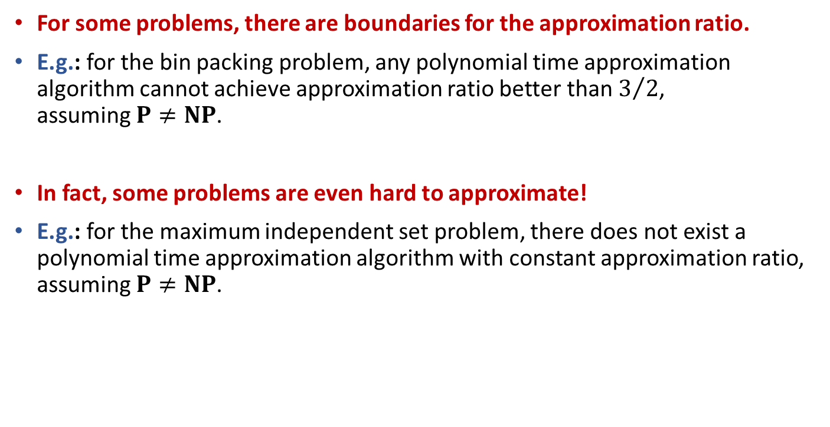
Inapproximability
For some problems, there are boundaries for the approximation ratio.
E.g.: for the bin packing problem, any polynomial time approximation algorithm cannot achieve approximation ratio better than $3/2$, assuming $P≠NP$.
In fact, some problems are even hard to approximate!
E.g.: for the maximum independent set problem, there does not exist a polynomial time approximation algorithm with constant approximation ratio, assuming $P≠NP$.

Slide 15
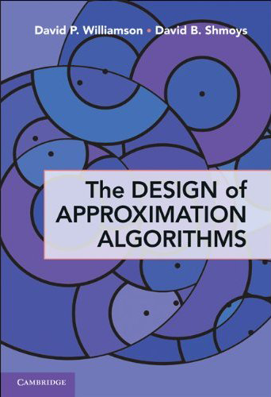

If you want to know more…
[CLRS] Ch.35
Other great books:
Williamson and Shmoys, The Design of Approximation Algorithms
Vijay Vazirani, Approximation Algorithms

Slide 16
Randomized Algorithms
Probability and Computing

Slide 17

Balls-into-Bins Model
uniformly at random choose h: [m]→[n]
m balls
uniformly and independently thrown into
n bins
Question: maximum number of balls in a bin?

Slide 18
Chernoff Bounds

Slide 19
(Convenient) Chernoff Bounds

Slide 20
Load Balancing
“m balls are thrown into n bins uniformly and independently at random”
“uniformly at random choose h: [m]→[n]”
Question: maximum number of balls in a bin?

Slide 21



Chernoff Bounds in Action: Load Balancing
“m balls are thrown into n bins uniformly and independently at random”
Question: maximum number of balls in a bin?
X_{i}: load of bin i
Y_{ij}: i.r.v. taking value 1 iff ball j lands in bin i
For $m=n$, $μ=1$
implies
when $t≥\frac{e\ln{n}}{\ln{\ln{n}}}$ and $n$sufficiently large
when $m=Θ(n)$ max load is $O\left(\frac{\log{n}}{\log{\log{n}}}\right)$ w.h.p.

Slide 22



Chernoff Bounds in Action: Load Balancing
“m balls are thrown into n bins uniformly and independently at random”
Question: maximum number of balls in a bin?
For $m≥n\ln{n}$, $μ≥\ln{n}$
when $m=Ω(n\log{n})$ max load is $O\left(\frac{m}{n}\right)$ w.h.p.
when $m=Ω(n\log{n})$ min load is $Ω\left(\frac{m}{n}\right)$ w.h.p.

Slide 23
Load Balancing
“m balls are thrown into n bins uniformly and independently at random”
Question: maximum number of balls in a bin?

Slide 24

Power of Two Choices
“m balls are thrown into n bins in the following manner:
for each ball, choose two bins uniformly and independently at random,
then place the ball in the less loaded bin”
Question: maximum number of balls in a bin?
$Ο\left(\frac{\log{n}}{\log{\log{n}}}\right)$ versus $Ο\left(\log{\log{n}}\right)$, exponential gap

Slide 25




Power of $d$ Choices
“m balls are thrown into n bins in the following manner:
for each ball, choose $d≥2$ bins uniformly and independently at random,
then place the ball in the less loaded bin”
the max loaded bin has $Ο(\log^{(d)}{n})$ balls, w.h.p.
the max loaded bin has $Ο\left(\frac{\log{\log{n}}}{\log{d}}\right)$ balls, w.h.p.

Slide 26
Hoeffding’s Inequality

Slide 27
(Convenient) Hoeffding’s Inequality

Slide 28



Hoeffding’s Inequality in Action: Randomized Quicksort
1
7
2
3
B
5
9
C
4
8
A
6
sort n distinct elements using QuickSort
choose pivot independently and uniformly at random each time
1
2
3
5
4
6
B
9
C
8
A
expected cost under adversarial input:
$$Θ(n\log{n})$$
1
2
5
4
6
9
8
B
C
worst case cost under any input:
$$Θ(n^{2})$$
1
4
6
9
C
Question: probability that the cost is $ω(n\log{n})$?

Slide 29


Hoeffding’s Inequality in Action: Randomized Quicksort
Question: probability that the cost is $ω(n\log{n})$?
The cost will be at most $30n\lg{n}$ with high probability.
1
7
2
3
B
5
9
C
4
8
A
6
1
2
3
5
4
6
B
9
C
8
A
1
2
5
4
6
9
8
B
C
???
1
4
6
9
C
???

Slide 30
The Probabilistic Method
The probabilistic method is a way of proving the existence of objects, using tools/techniques from probability theory.
Probabilistic proofs for deterministic theorems!
Goal:
Prove the existence of objects with certain properties.
Basic Idea:
Construct a sample space of objects.
Show the probability that a randomly chosen object has the desired properties is positive. (Use tools/techniques from probability theory.)

Slide 31

Simple example of the probabilistic method No Large Monochromatic Clique
Question: Can we color edges of 1000-nodes clique with red and blue, so that there is no monochromatic 20-nodes clique?
The answer is Yes!
Proof (by using the probabilistic method):
Color the edges of $K_{1000}$ independently and uniformly at random.
There are $\left(\begin{matrix}1000 \\ 20\end{matrix}\right)$ $K_{20}$ in $K_{1000}$, let $A_{i}$ be the event that the $i$^{th} $K_{20}$ is monochromatic.
$\operatorname{Pr}\left[A_{i}\right]=2^{−\left(\begin{matrix}20 \\ 2\end{matrix}\right)+1}$
$\operatorname{Pr}\left[\bigcap_{i}{\overline{A_{i}}}\right]=1−\operatorname{Pr}\left[\bigcup_{i}{A_{i}}\right]≥1−\left(\begin{matrix}1000 \\ 20\end{matrix}\right)⋅2^{−\left(\begin{matrix}20 \\ 2\end{matrix}\right)+1}$ $\operatorname{Pr}\left[\bigcap_{i}{\overline{A_{i}}}\right]≥1−8.5⋅{10}^{−16}>0$
A simple random algorithm with small error probability: Color each edge independently and uniformly at random.

Slide 32

Simple example of the probabilistic method Max Satisfiability of 3-CNF
Max-E3SAT: Given a Boolean formula $φ$ in 3-CNF form, in which each clause has exactly 3 literals, how many clauses can be satisfied at most?
This problem is NP-hard! (Since 3SAT reduces to it.)
But for any $φ$, at least $7/8$ clauses are satisfiable!
Proof (by using the probabilistic method):
Consider a uniform and random assignment of all Boolean variables.
Assume $φ$ has $k$ clause. Define $X_{i}$ to be i.r.v. taking value $1$ iff the $i$^{th} clause is satisfied. Define $X$ to be number of clauses satisfied in total: $X=\sum_{i=1}^{k}{X_{i}}$.
$𝔼\left[X_{i}\right]=\operatorname{Pr}\left[X_{i}=1\right]≥7/8$
$𝔼\left[X\right]=\sum_{i=1}^{k}{𝔼\left[X_{i}\right]}≥{7k}/8$

Slide 33
Derandomization
To prove the existence of objects satisfying certain properties, the probabilistic method often provides non-constructive proofs.
Such objects exist, but how to find it, efficiently?!
Proofs often lead to randomized algorithms with failure probability. (Random coloring in Mono-Clique, random assignment in Max-E3SAT.)
Use derandomization technique to develop deterministic algorithms, that guarantee to find objects with required properties!

Slide 34

Derandomization of Max-E3SAT Method of Conditional Expectation
Consider the MAX-E3SAT problem, assume $φ$ has $n$ variables. Consider the process of randomly assigning 0/1 to $\left\{x_{1},⋯,x_{n}\right\}$. Let $X$ denote the number of satisfied clauses.
$𝔼\left[X\right]=0.5⋅𝔼\left[X | x_{1}=0\right]+0.5⋅𝔼\left[X | x_{1}=1\right]$
${7k}/8≤𝔼\left[X\right]≤\max\left\{𝔼\left[X | x_{1}=0\right],𝔼\left[X | x_{1}=1\right]\right\}$
$\max\left\{𝔼\left[X | x_{1}=0\right],𝔼\left[X | x_{1}=1\right]\right\}=𝔼\left[X | b_{1}\right]≥{7k}/8$
$𝔼\left[X | b_{i}\right]=0.5⋅𝔼\left[X | b_{i},x_{i+1}=0\right]+0.5⋅𝔼\left[X | b_{i},x_{i+1}=1\right]$
${7k}/8≤𝔼\left[X | b_{i}\right]≤\max\left\{𝔼\left[X | b_{i},x_{i+1}=0\right],𝔼\left[X | b_{i},x_{i+1}=1\right]\right\}$
$\max\left\{𝔼\left[X | b_{i},x_{i+1}=0\right],𝔼\left[X | b_{i},x_{i+1}=1\right]\right\}=𝔼\left[X | b_{i+1}\right]≥{7k}/8$
$𝔼\left[X | b_{n}\right]≥{7k}/8$, but $b_{n}$ is a deterministic assignment of all variables!

Slide 35


If you want to know more…
[CLRS] Ch.5
Other great books:
Mitzenmacher and Upfal, Probability and Computing
Motwani and Raghavan, Randomized Algorithms

